Slide 1
Elements Report Generation – Temerty Medicine Info Type Mapping
November 14, 2025
Presented by:
MedIT Elements Team

Slide 2
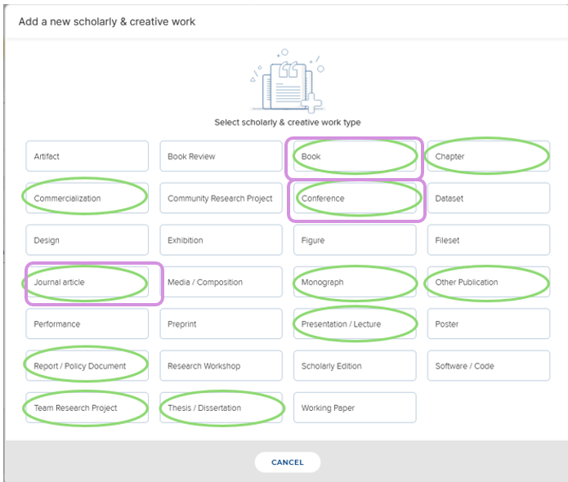
Scholarly and Creative works module in Elements
Green circles indicate info types that are mapped to TFoM Customized reports
Purple squares indicate info types that have data suggested for claiming

Slide 3
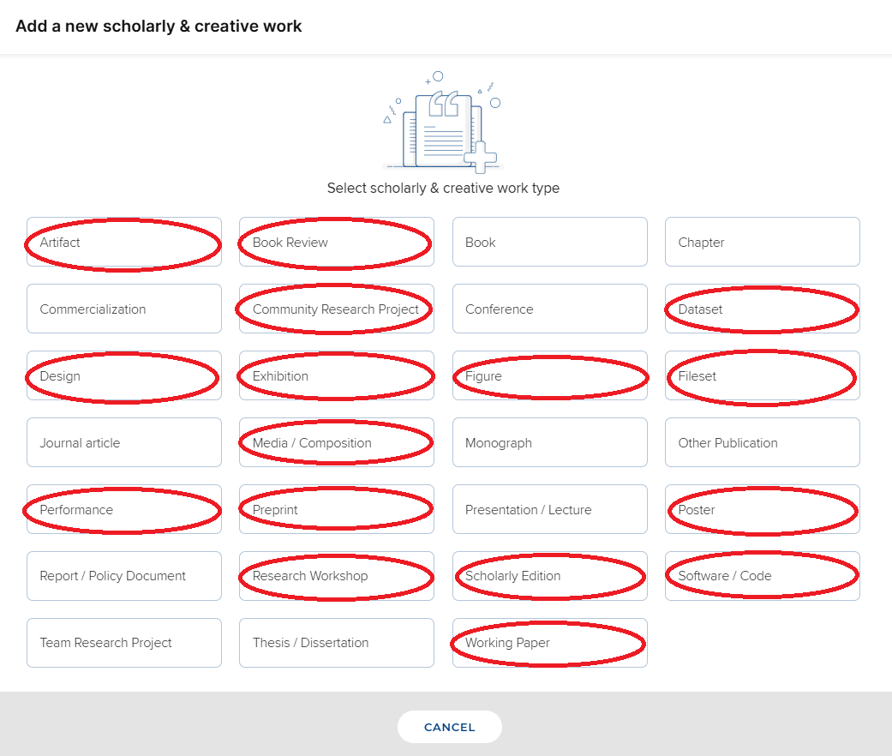
Scholarly and Creative works module in Elements
Red circles indicate info types that are NOT mapped to TFoM Customized reports as of July 2025
Data entered in these info types will not extract into a TFoM customized report

Slide 4
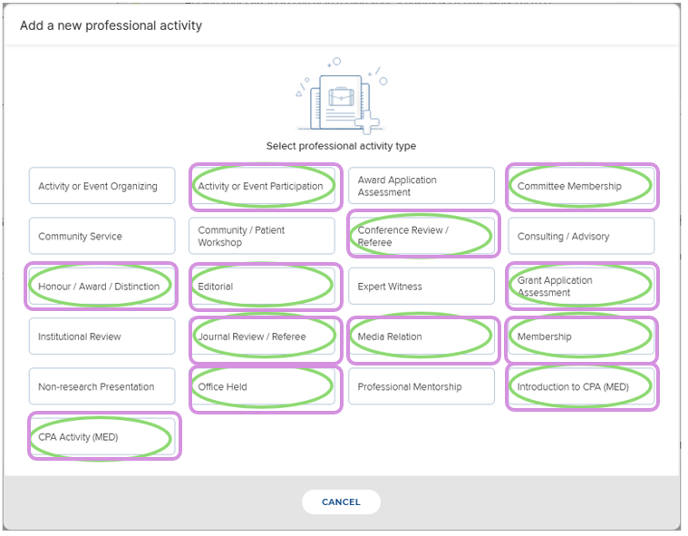
Professional Activities module in Elements
Green circles indicate info types that are mapped to TFoM Customized reports
For Department of Medicine only, purple square indicate info types where data was batch uploaded from WebCV (data was extracted as of February 28, 2025)

Slide 5
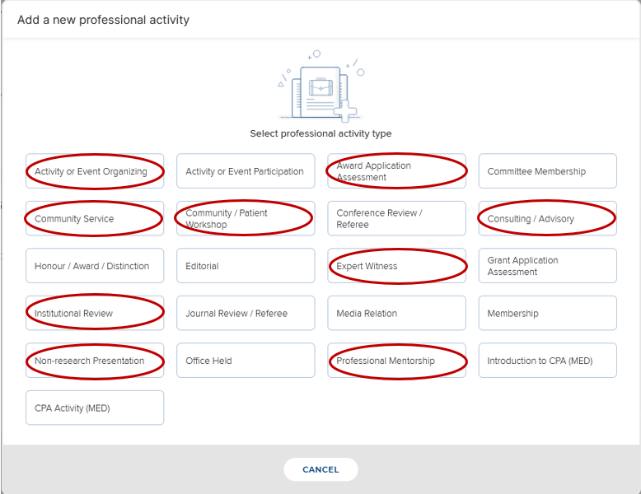
Professional Activities module in Elements
Red circles indicate info types that are NOT mapped to TFoM Customized reports as of July 2025
Data entered in these info types will not extract into a TFoM customized report

Slide 6
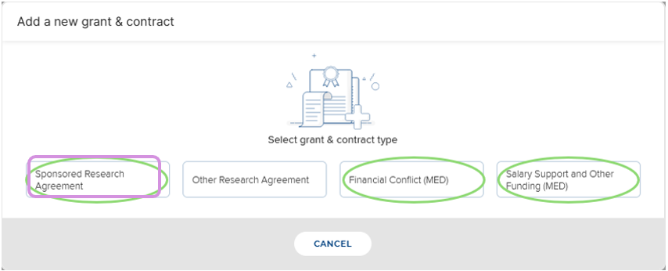
Grants & Contracts module in Elements
Green circles indicate info types that are mapped to TFoM Customized reports
Purple squares indicate info types that have data pushed to Elements from the UofT Grant database, which includes an annual update on grants held at hospital sites

Slide 7
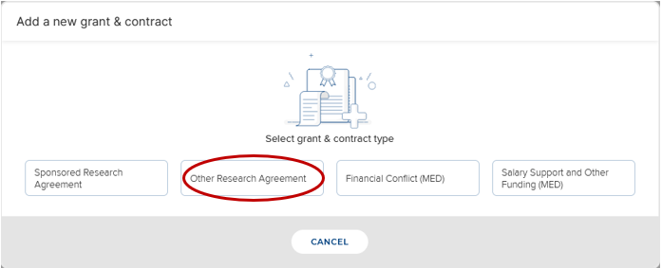
Grants & Contracts module in Elements
Red circles indicate info types that are NOT mapped to TFoM Customized reports as of July 2025
Data entered in these info types will not extract into a TFoM customized report

Slide 8
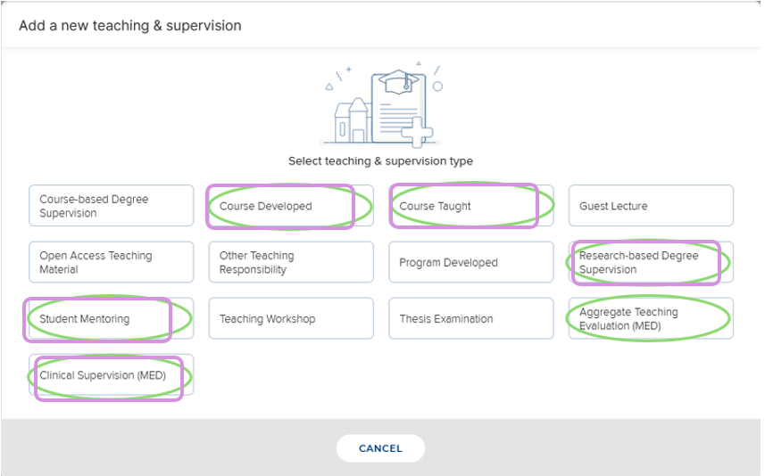
Teaching & Supervision module in Elements
Green circles indicate info types that are mapped to TFoM Customized reports
For Department of Medicine only, purple square indicate info types where data was batch uploaded from WebCV (data was extracted as of April 25, 2024)

Slide 9
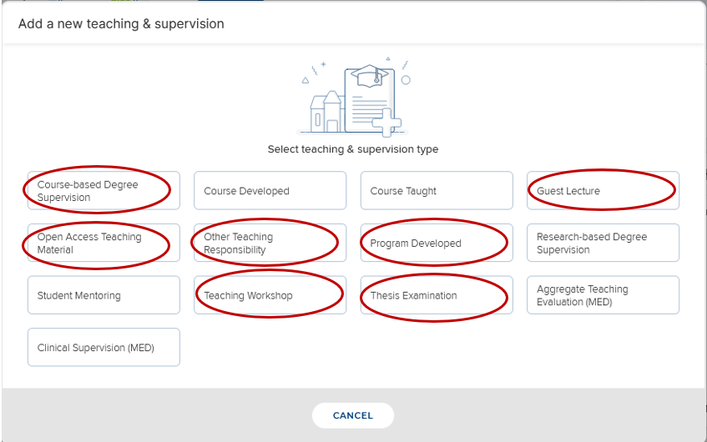
Teaching & Supervision module in Elements
Red circles indicate info types that are NOT mapped to TFoM Customized reports as of July 2025
Data entered in these info types will not extract into a TFoM customized report

